Slide 1
Math / Physics 101
GAM 376/476

Slide 2
Math / Physics
Topics
Mathematics
Coordinate System
Functions and Equations
Trigonometry
Vectors
Physics
Time
Distance
Mass
Position / Velocity / Acceleration
Force

Slide 3
Math / Physics
If you want to learn A.I., mathematics cannot be avoid.
All A.I. is built on different mathematic principles.
It is true, you could copy and paste the formulas
This will build your project around the formula, rather then build your formula for your project.
You will have deeper understanding of A.I.

Slide 4
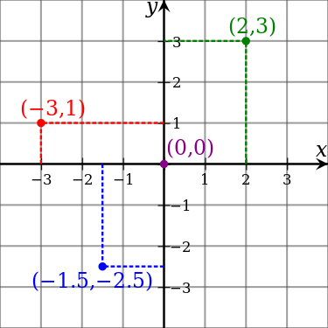
Coordinate System
Cartesian Coordinates
2D – defined by two axes
3D – defined by three axes
A point in 2D space is defined by coordinate pair (x, y)
Origin located at (0, 0)

Slide 5
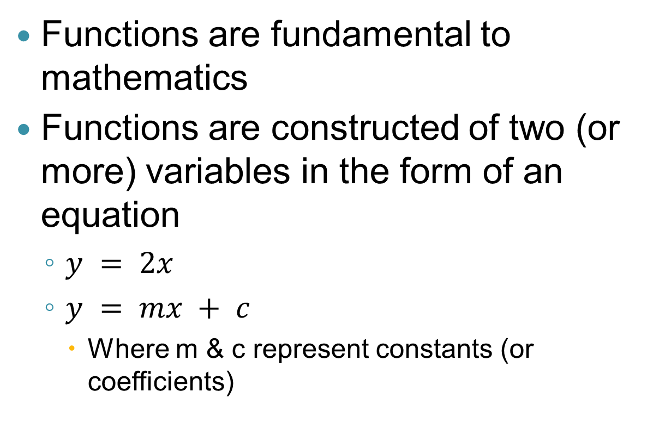
Functions & Equations
Functions are fundamental to mathematics
Functions are constructed of two (or more) variables in the form of an equation
$y = 2x$
$y = mx + c$
Where m & c represent constants (or coefficients)

Slide 6
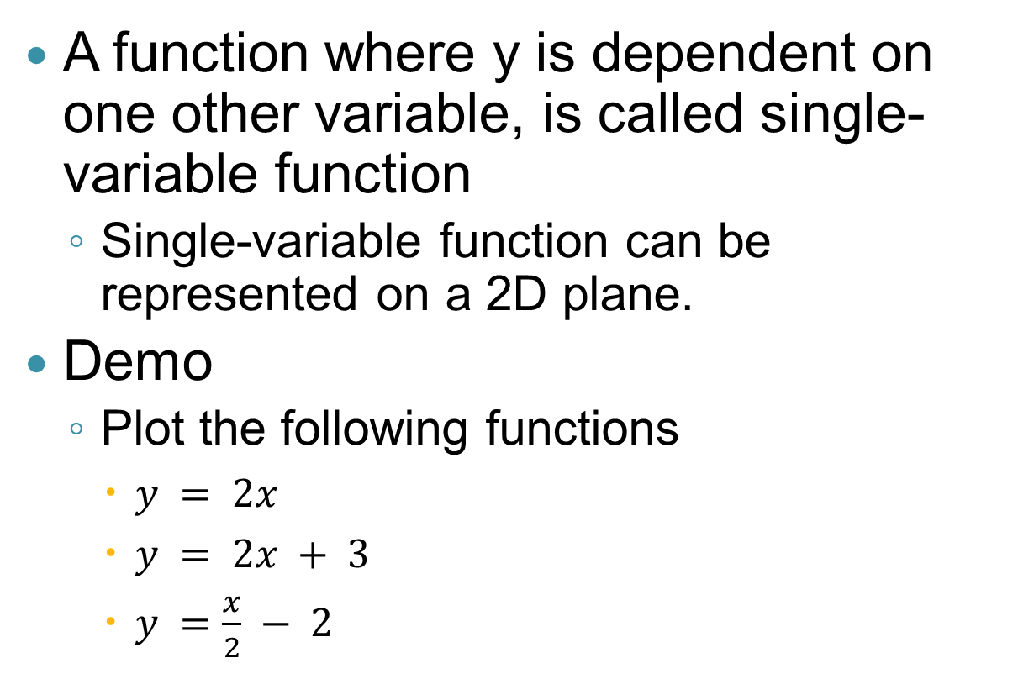
Functions & Equations
A function where y is dependent on one other variable, is called single-variable function
Single-variable function can be represented on a 2D plane.
Demo
Plot the following functions
$y = 2x$
$y = 2x + 3$
$y =\frac{x}{2} − 2$

Slide 7
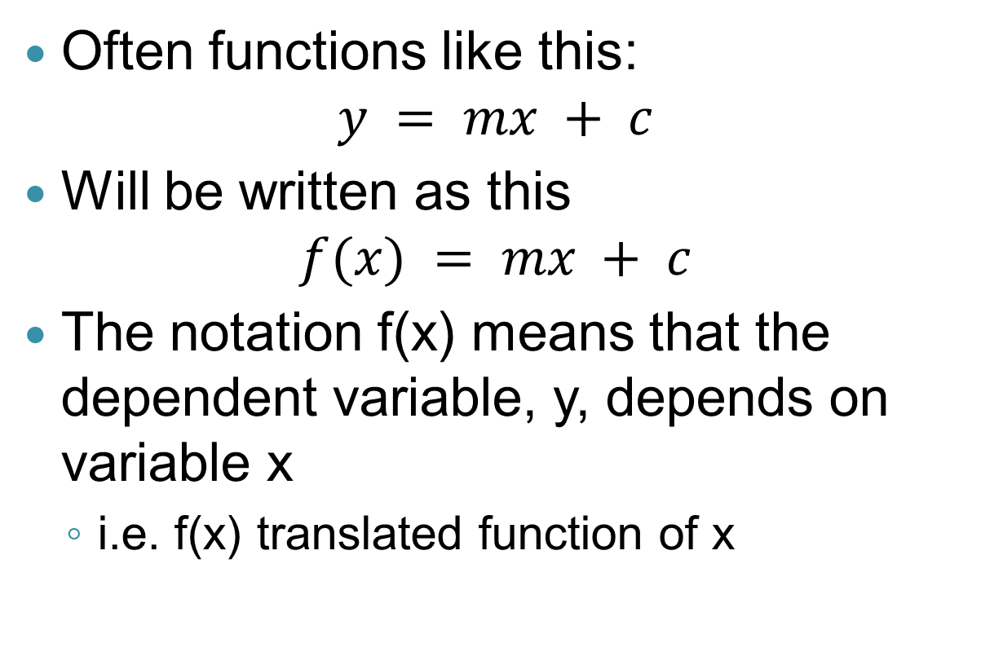
Functions & Equations
Often functions like this:
$$y = mx + c$$
Will be written as this
$$f(x) = mx + c$$
The notation f(x) means that the dependent variable, y, depends on variable x
i.e. f(x) translated function of x

Slide 8
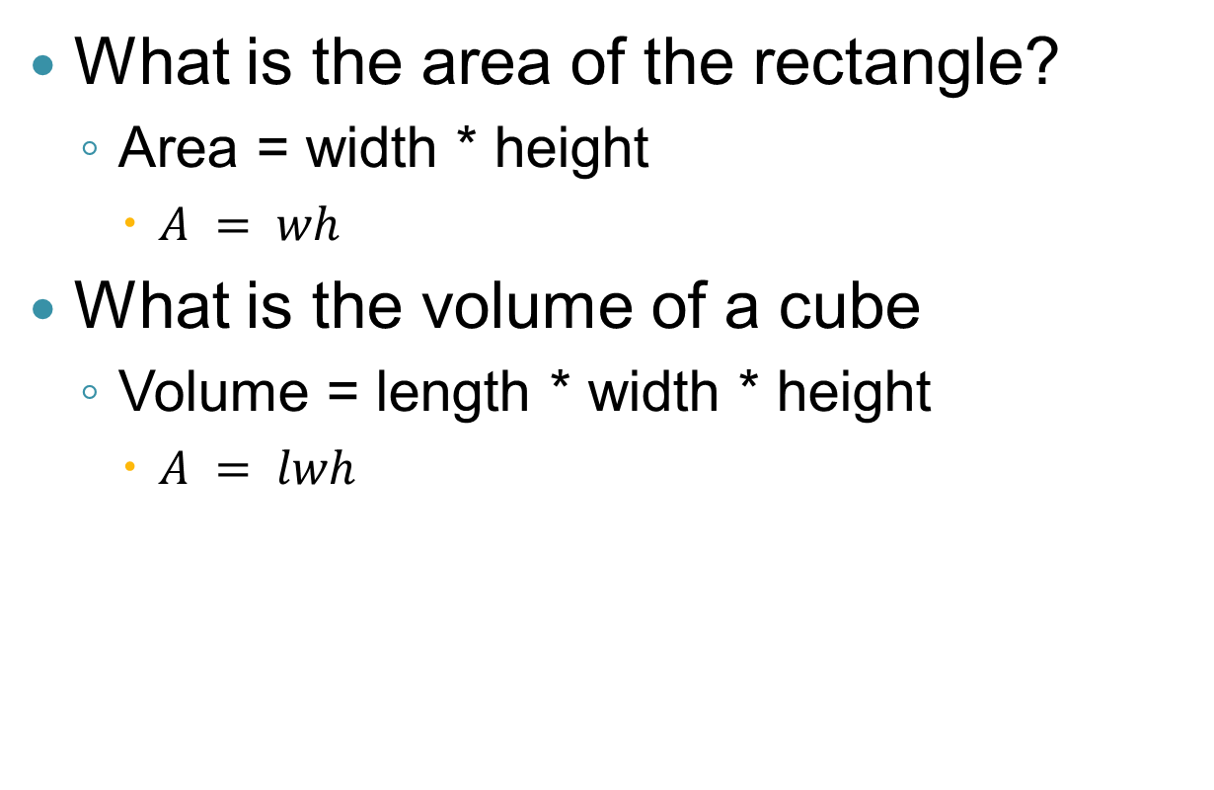
Functions & Equations
What is the area of the rectangle?
Area = width * height
$A = wh$
What is the volume of a cube
Volume = length * width * height
$A = lwh$

Slide 9

Exponential Functions
‘a’ is known as the base
‘x’ is know as the power
$f\left(x\right)=a^{x}$

Slide 10


Simplifying Equations
$3x+7=22 −2x$
$y=2\left(3x −5y\right)+\frac{x}{3}$
$5x −2y={\left(\frac{y−x}{\sqrt{x}}\right)}^{2}$
$x=3$
$y=\frac{19}{33} x$
$y=2x$

Slide 11
Trigonometry
Ray
Line with one endpoint
Line
Line with two endpoints
Angle
The measure of divergence between two rays

Slide 12
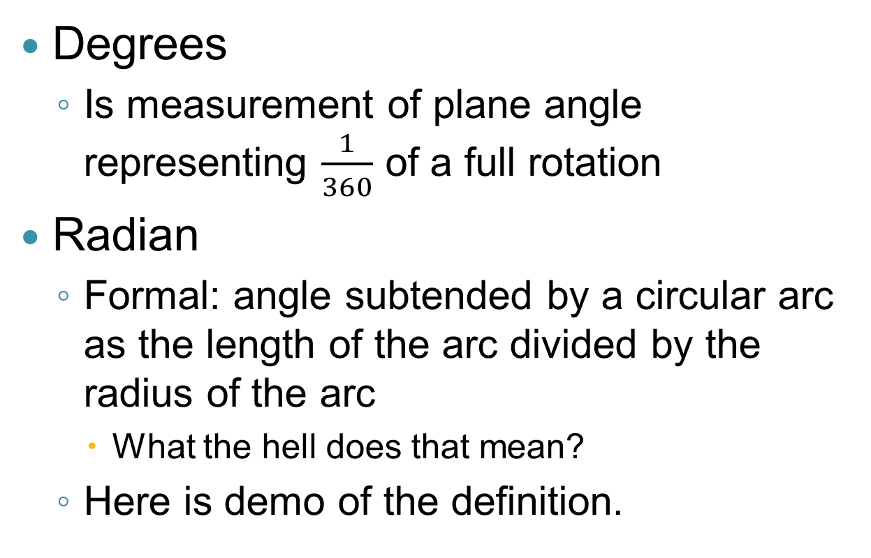
Degrees vs Radians
Degrees
Is measurement of plane angle representing $\frac{1}{360}$ of a full rotation
Radian
Formal: angle subtended by a circular arc as the length of the arc divided by the radius of the arc
What the hell does that mean?
Here is demo of the definition.

Slide 13
Why Radians
Here is explanation of the problem with degrees.
This example comes from betterExplained:
Suppose you saw a friend go running on a large track.
Following conversation ensues:

Slide 14
Why Radians
Problem with degrees:
“Hey Bill, how far did you go?”
“Well I had a really good pace, I think I went 6 or 7 mile-”
“Shutup. Don’t care. How far did I turn my head to see you move?
“Umm . . . What?”
“I’ll use small words for you. Me in the middle of track. You ran around. How . . . much . . . did . . I . . . turn . . my . . . damn . . . head!”

Slide 15
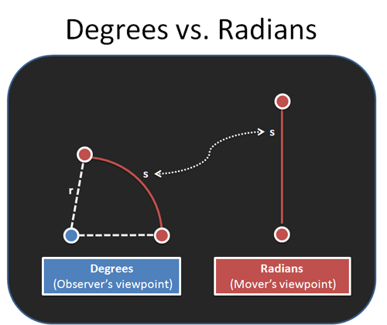
Why Radians

Slide 16
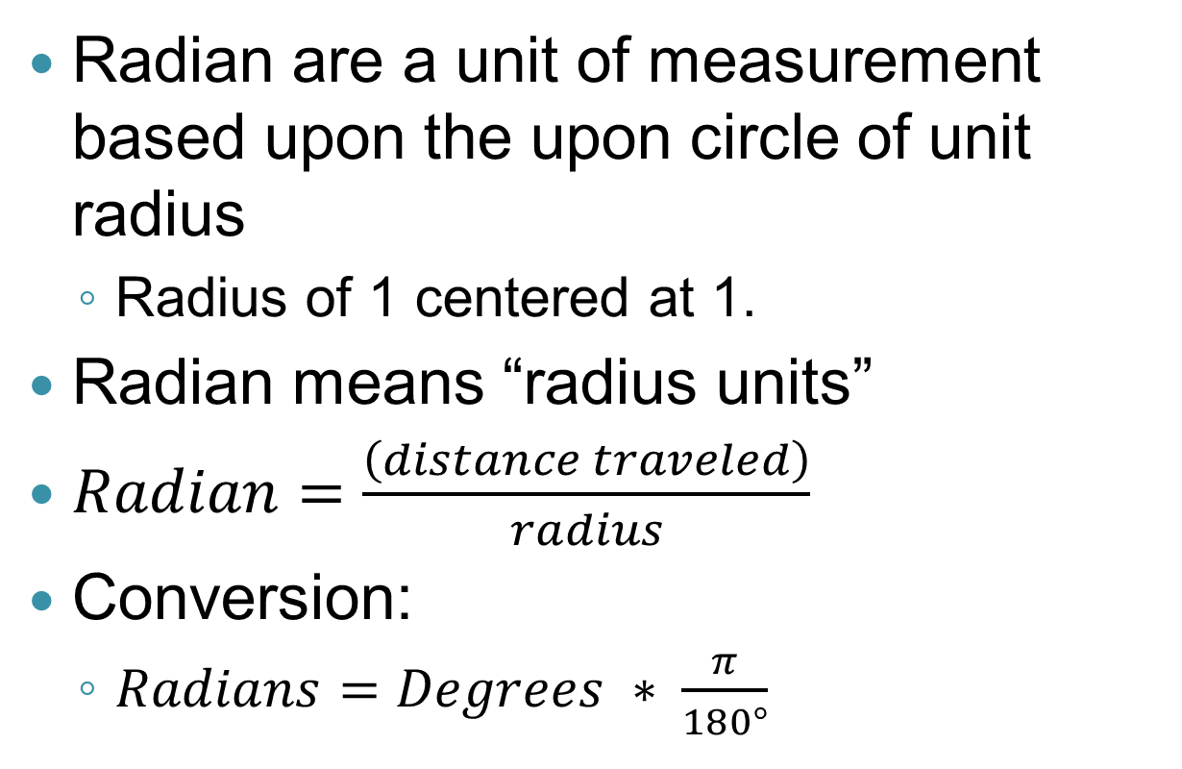
Radians
Radian are a unit of measurement based upon the upon circle of unit radius
Radius of 1 centered at 1.
Radian means “radius units”
$Radian=\frac{\left(distance traveled\right)}{radius}$
Conversion:
$Radians=Degrees ∗ \frac{π}{180°}$

Slide 17
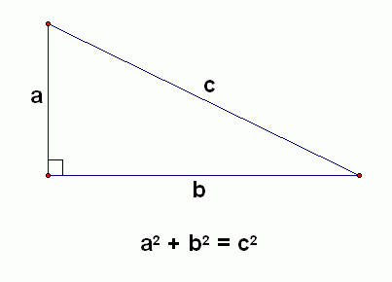
Pythagorean Theorem

Slide 18
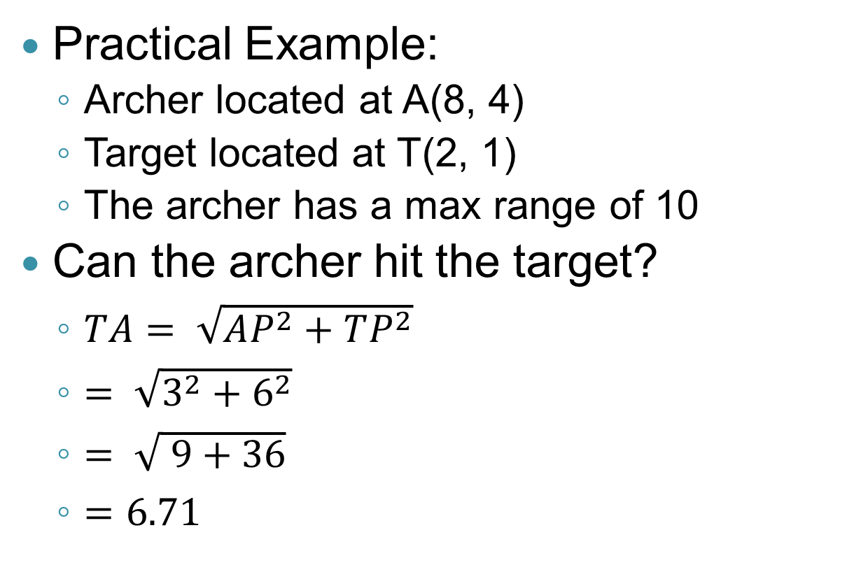
Pythagorean Theorem
Practical Example:
Archer located at A(8, 4)
Target located at T(2, 1)
The archer has a max range of 10
Can the archer hit the target?
$TA= \sqrt{AP^{2}+TP^{2}}$
$= \sqrt{3^{2}+6^{2}}$
$= \sqrt{ 9+36}$
$=6.71$

Slide 19
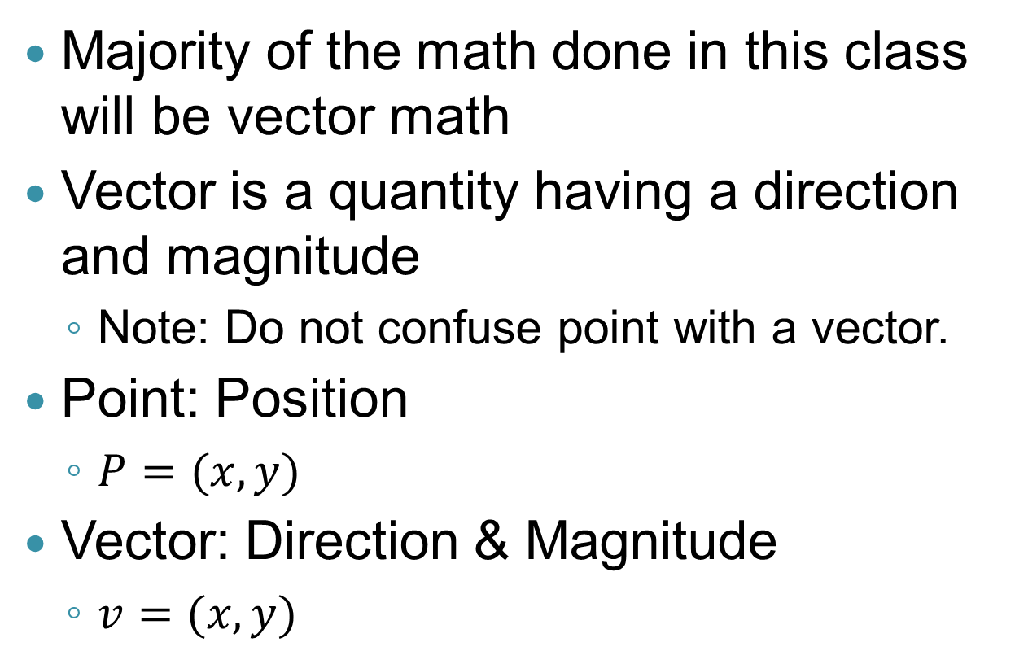
Vectors
Majority of the math done in this class will be vector math
Vector is a quantity having a direction and magnitude
Note: Do not confuse point with a vector.
Point: Position
$P=(x, y)$
Vector: Direction & Magnitude
$v=(x, y)$

Slide 20
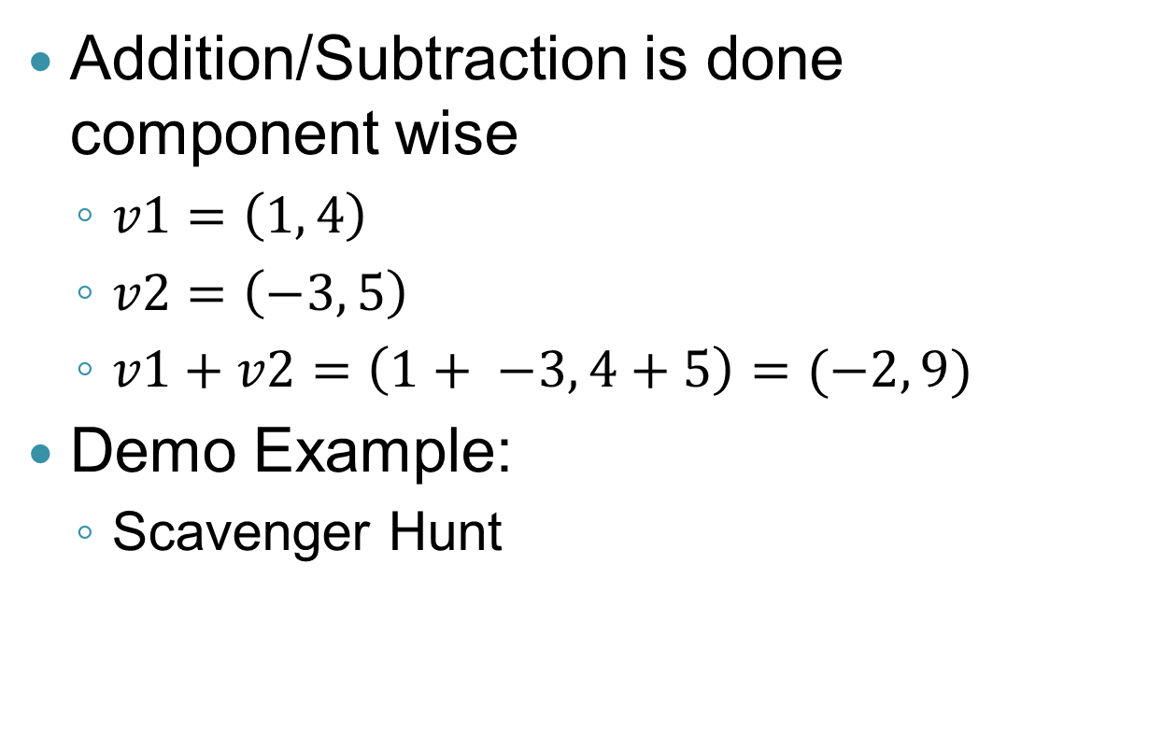
Adding/Subtracting Vectors
Addition/Subtraction is done component wise
$v1=\left(1, 4\right)$
$v2=\left(−3, 5\right)$
$v1+v2=\left(1+ −3, 4+5\right)=(−2, 9)$
Demo Example:
Scavenger Hunt

Slide 21

Multiplying Vectors by Scalars
$v=(3, 2)$
$s=2$
$s∗v=2∗\left(3, 2\right)=(6,4)$

Slide 22
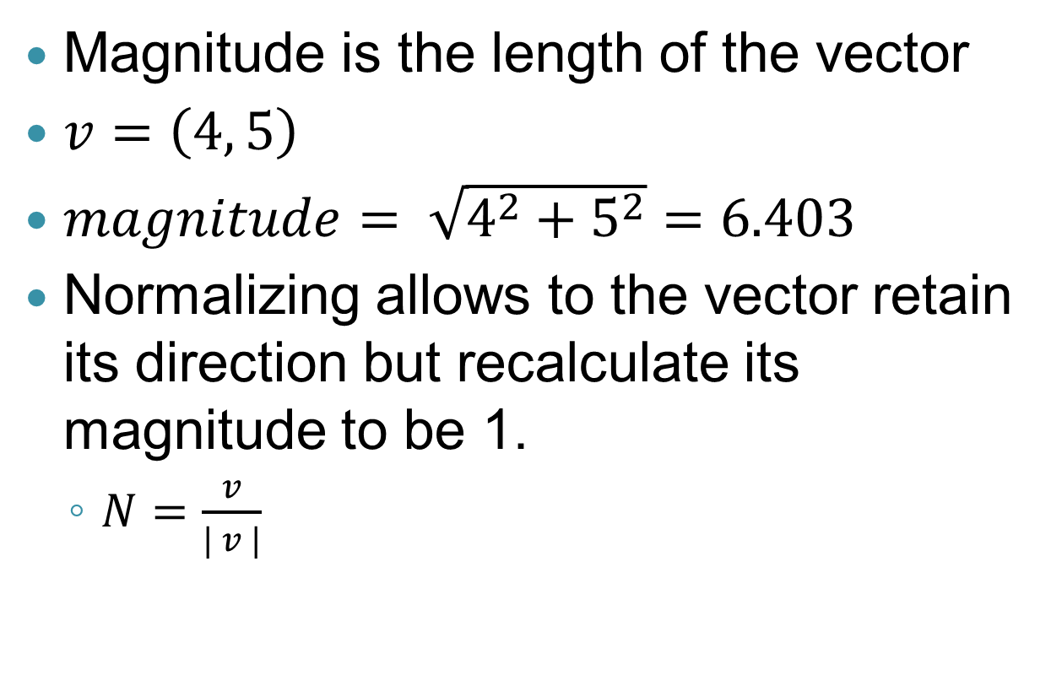
Magnitude & Normalizing
Magnitude is the length of the vector
$v=\left(4, 5\right)$
$magnitude= \sqrt{4^{2}+5^{2}}=6.403$
Normalizing allows to the vector retain its direction but recalculate its magnitude to be 1.
$N=\frac{v}{| v |}$

Slide 23
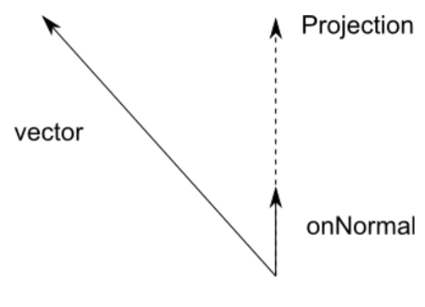
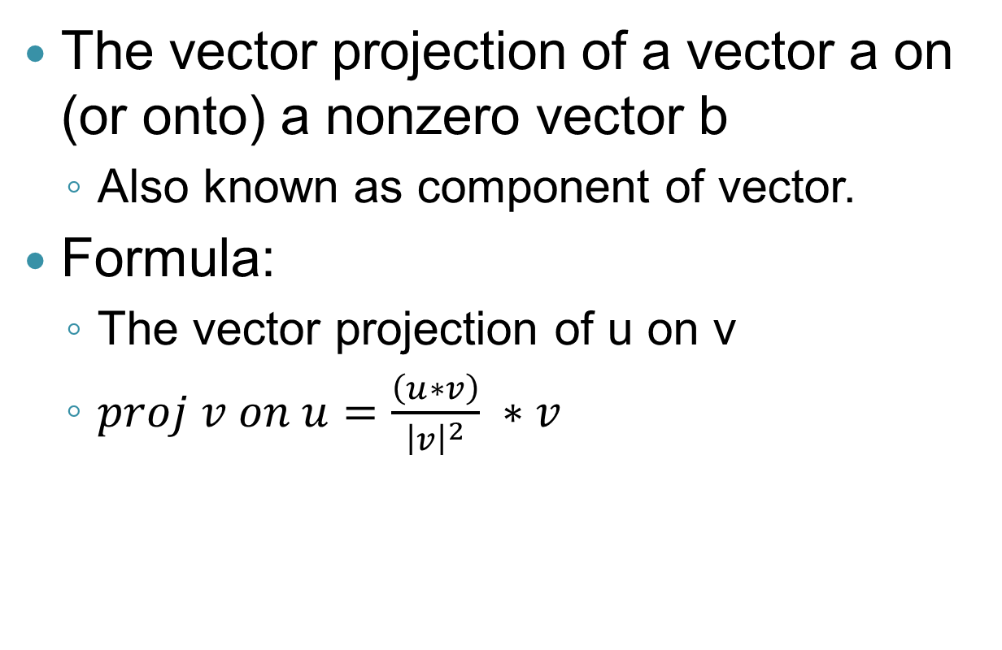
Projection
The vector projection of a vector a on (or onto) a nonzero vector b
Also known as component of vector.
Formula:
The vector projection of u on v
$proj v on u=\frac{\left(u∗v\right)}{{\left|v\right|}^{2}} ∗v$

Slide 24
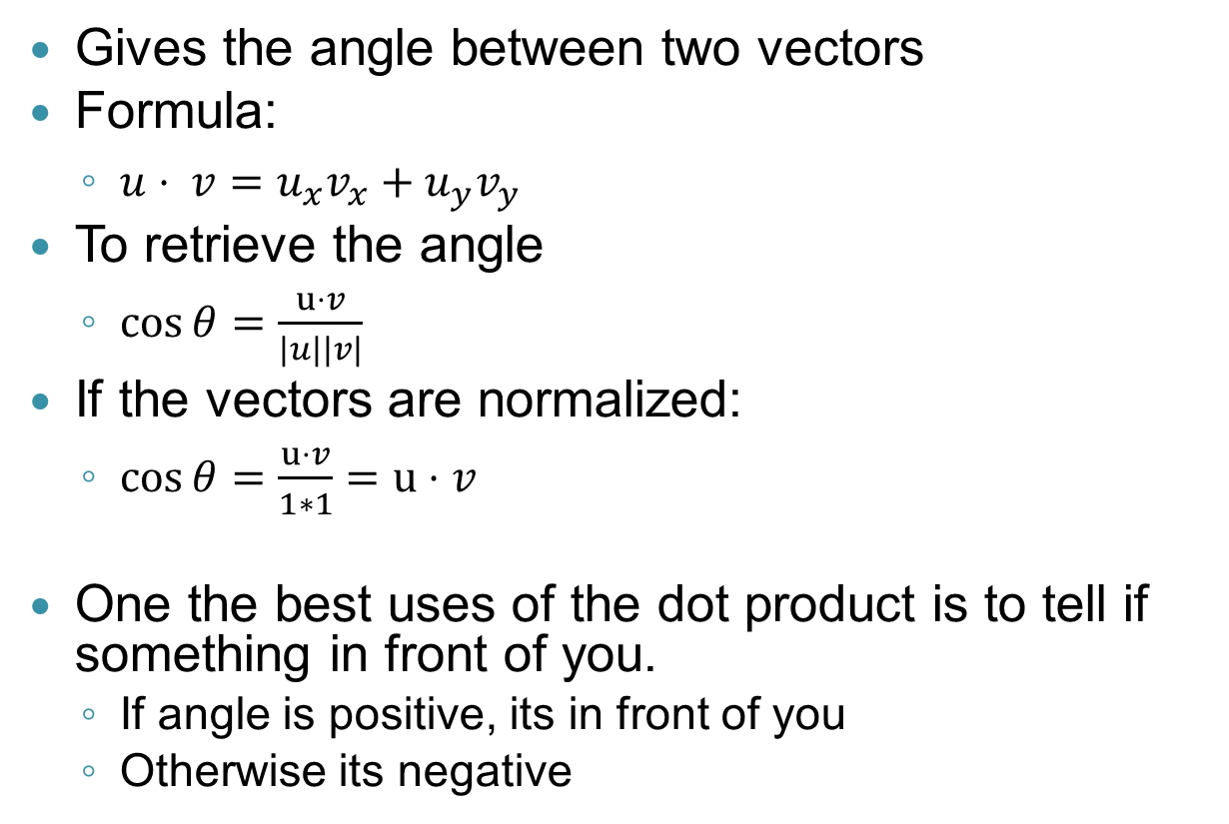
Dot Product
Gives the angle between two vectors
Formula:
$u⋅ v=u_{x}v_{x}+u_{y}v_{y}$
To retrieve the angle
$\cos{θ}=\frac{u⋅v}{\left|u\right||v|}$
If the vectors are normalized:
$\cos{θ}=\frac{u⋅v}{1∗1}=u⋅v$
One the best uses of the dot product is to tell if something in front of you.
If angle is positive, its in front of you
Otherwise its negative

Slide 25
Coordinate transformations
We will always want to move back and forth between coordinate systems
objects each have their own local coordinate systems
related to each other in "world space"
Example
NPC
a character is at a particular position, facing a particular direction
he defines a coordinate system
Door
the door has its own coordinate system
in that system, the handle is in a particular spot
To make the character reach for the handle
we have to make the two coordinate systems interact

Slide 26
World to local transformation
My character needs to go to a particular point in the world
where is that point relative to the character?
does he turn left / right?
In graphics
this kind of transformation is used all the time
because we “go to” where an object is
in order to draw it using local (model) coordinates

Slide 27
Local to world transform
The character drops a weapon
where is that in the world?

Slide 28
Local to world transform
The character drops a weapon
where is that in the world?

Slide 29
Transformations
We know
where the handle is in door space
where the agent's hand is in agent space
what is the vector in agent space
Set of transformations
transform handle location L₀ to world space L_{w}
transform handle location to agent space L_{a}
Each transformation
is a translation (changing the origin)
and a rotation changing the orientation

Slide 30
Affine transformations
Usually coordinate transformations are done through matrix multiplications
we multiply a vector by a matrix and get another vector out
The curious thing is
that to do this we have to use vectors and matrices one size larger than our current number of dimensions
you will see <x, y, 1> as the representation of 2-D vector and <x,y,z,1> for 3-D

Slide 31
Matrix math
2-D dimensional array
Matrix multiplication
F x G
dot product of
rows of F
columns of G
corollary
multiplication only works
if # cols of F = # rows of G

Slide 32
Matrix math
Can also multiply a vector times a matrix
Mv
Result
a new vector
each entry
a dot product of v with a different row of M
length of v
must equal number of cols in M

Slide 33
Example
rotation around the origin by angle θ
matrix
multiply by current vector
<1, 1> becomes <1, 1, 1>
answer
x = cos(θ) – sin (θ) + 0
y = sin(θ) + cos(θ) + 0
z = 1

Slide 34
x' = x cos(θ) – y sin(θ)
y' = x sin(θ) + y cos(θ)

Slide 35
Translation
Achieved by adding values at the ends of the top two rows
This rotates and translates by (3, -4)

Slide 36
Efficiency
Mathematical operations are expensive
especially trigonometric ones (inverse cosine)
also square root
multiplication and division, too
Normalization is particularly expensive
square root, squaring and division
We want to consider ways to make our calculations faster
especially if we are doing them a lot
Or better yet
avoid calculations

Slide 37
Kinematics
the physics of motion
we worry about this a lot in computer games
moving through space, collisions, etc.
our NPCs have to understand this too in order to avoid stupidity

Slide 38
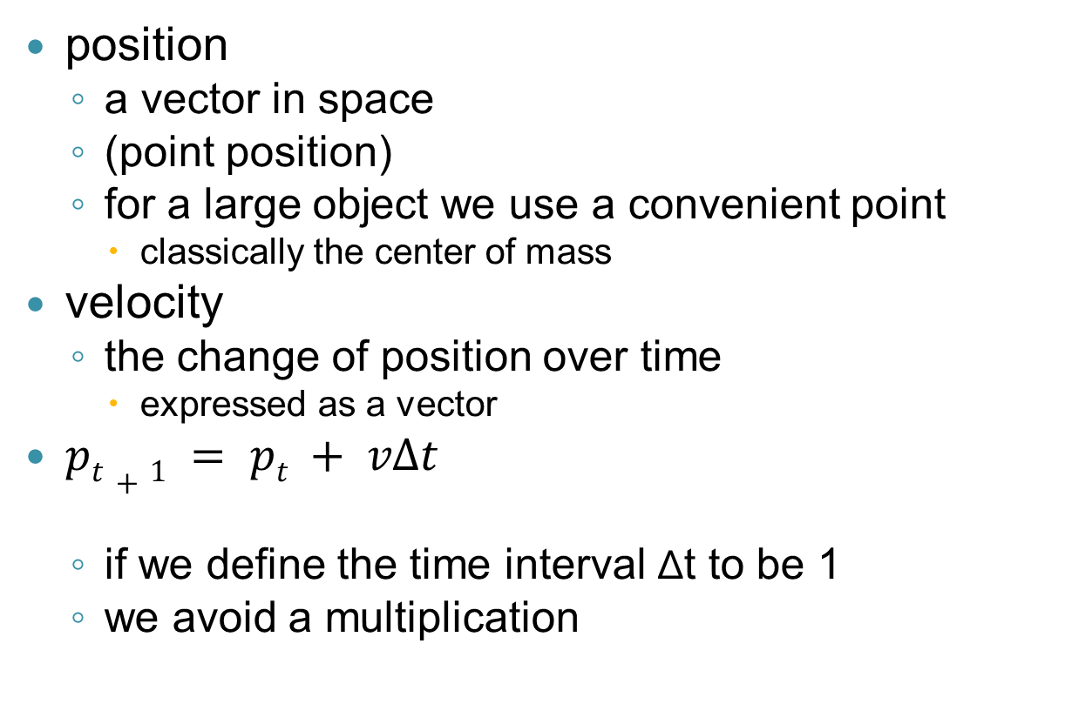
Basic kinematics
position
a vector in space
(point position)
for a large object we use a convenient point
classically the center of mass
velocity
the change of position over time
expressed as a vector
$pt+1 = pt + vΔt$
if we define the time interval Δt to be 1
we avoid a multiplication

Slide 39
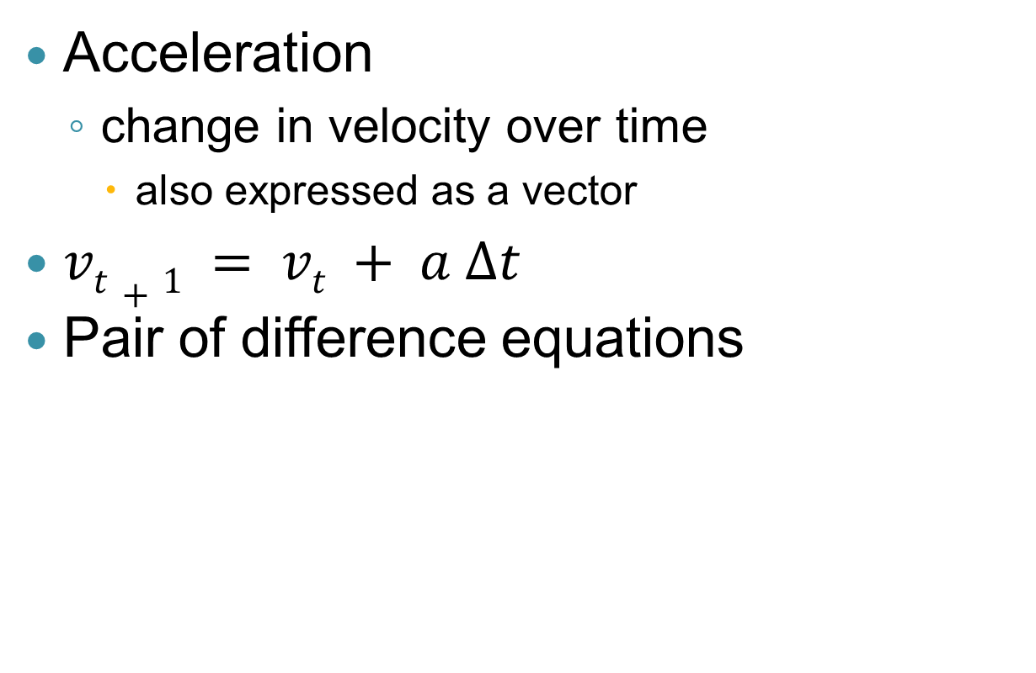
Basic kinematics II
Acceleration
change in velocity over time
also expressed as a vector
$vt+1 = vt + a Δt$
Pair of difference equations

Slide 40
What does this have to do with AI?
Imagine a NPC
he has to decide how hard to throw a grenade
that judgment has to be based on an estimate of the item’s trajectory
When NPC take physical actions
we have to know what the parameters of those actions should be
very often physics calculations are required
not as detailed as the calculations needed to run the game

Slide 41
Approximation in Prediction
NPC will frequently need to predict the future
where will the player be by the time my rocket gets there?
Assumptions
current velocity stays constant
we know the speed of the rocket
Correct way
vector algebra
lots of square roots and trig functions
Typical approximation
use the current distance
won't change that much if the rocket is fast

Slide 42
Accuracy?
Accuracy may be overrated
for NPC enemies
We want an enjoyable playing experience
no warning sniper attack is realistic
but no fun
a game has to give the player a chance
Built-in inaccuracy
many games have enemies deliberately miss on the first couple of shots
others build random inaccuracy into all calculations
others use weak assumptions about physics
simplify the calculations
and give a degree of inaccuracy

Slide 43
Force
Netwon's law
F = m*a
In other words
acceleration is a function of force and mass
Force is also a vector quantity
a force acting along a vector
imparts a velocity along that vector

Slide 44
Example
When a bat hits a ball
we will want to determine the force imparted to the ball
we could simulate this with the mass of the bat and its speed
more likely, we would just have a built-in value
direction of the force
we need to know the angle of the bat when it strikes the ball

Slide 45
More complex motions
To handle rotation
we also have to worry about torque and angular momentum
For example
if a rocket hits the back of a car
it will spin
if it hits the center, it will not

Slide 46
Torque
Force applied around the center of mass of an object
torque gives rise to angular acceleration (spin)
t = d F = I α
d = moment arm

Slide 47
For our purposes
We will ignore rotational motion
deal only with forces acting on points
typical simplification for AI

